Slide 1
IBM WebSphere Operational Decision Manager/ILOG Training

Slide 2
Introduction to BRMS
Operational vs Analytical Business
Application Code and Decision Codes
Business Rules
Roles and Responsibilities
Components

Slide 3
Disadvantages of Traditional Approach
Rules are hidden in code or isolated within the organization
Changes are hard to track and maintain over time
Rules used by systems have to be programmed and require IT resources
Duplication and multiple versions of the same rules
Lack of auditability, traceability
Decision changes cannot be easily tested or simulated

Slide 4





What makes BRMS
Hassle free Development/Testing/Deployment/Integration
Make decision logic accessible to Business and IT
Allow business users to manage rules
Reduce maintenance time/cost
Asynchronous mode of development
Basic english would do
Rules are Defined, Analyzed and Maintained
Rules are Stored and Shared
Rules are Deployed, Executed and Monitored
User Tools
Rule Repository
Rule Server

Slide 5



BRMS Components and Roles
Decision Server
          Development Team
          Rule Studio
Decision Center
Architect , Business Analyst , Business Users
Team Server , Business Console , Rule Solution for Office
Server
Administrator
Rule Execution Server

Slide 6
Rules Life Cycle
Design
Analyze Author
Monitor Validate
Execute Test
Deploy

Slide 7
Business Rules/Decision
IF the Total purchases of Account > $2,500
THEN the enterprise value of Customer is GOLD
IF the location of Customer is HYD
THEN the rate of interest of Policy is 5%
IF the salary of Employee is more than 500000
THEN the tax rate of Employee is 5%

Slide 8
Business Rule Language
  Customizable vocabulary specific to your organization, industry, application (etc.)
  Supports language localization
  Integrates with external data sources (e.g. list of countries)
  Drop down lists for customized domain data
  Templates facilitate new rule creation

Slide 9
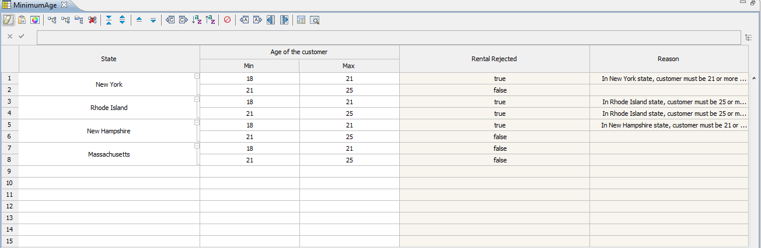
Decision Tables

Slide 10
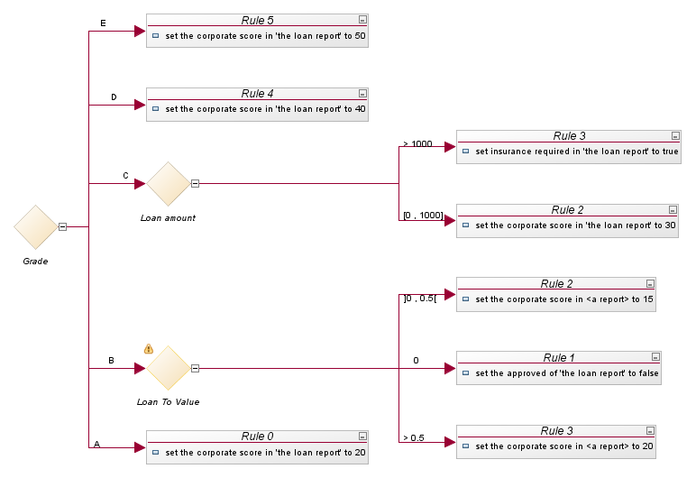
Decision Trees
Values
Actions
Condition

Slide 11
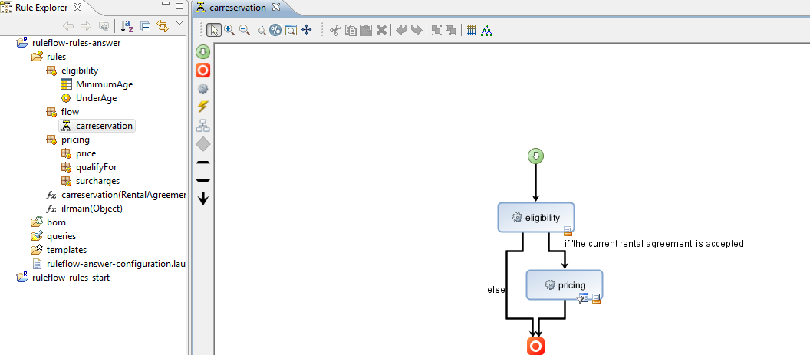
RuleFlow

Slide 12
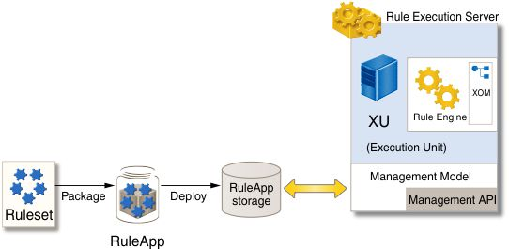
Rule Execution Server
RuleApp and Ruleset
Integrate with Java, XML, WSDL
Exposes rule services as
  Rule Session (POJO, EJB or MDB)
  Transparent Decision Services (Web Services)
Rule services management & monitoring
  Rule Persistence and Versioning
  Rule Execution statistics & trace

Slide 13
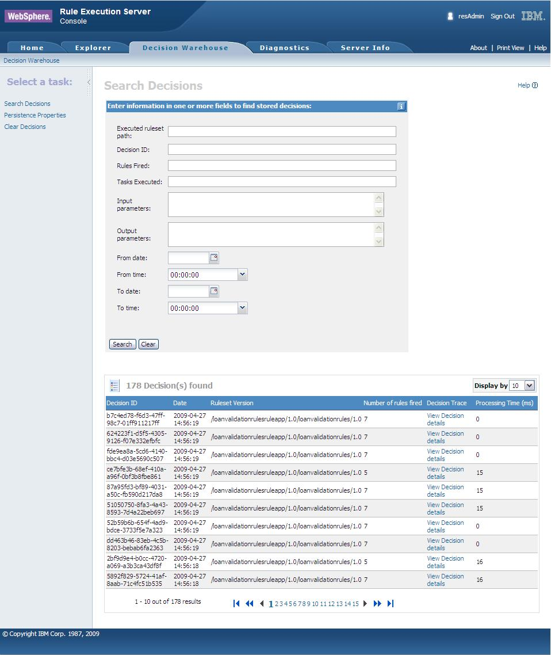
Decision Warehouse in RES
Traces decisions in production applications
  Logs execution trace
  Input / Output data
  Execution results
  Executed Tasks
  Rules Fired
  Queries

Slide 14
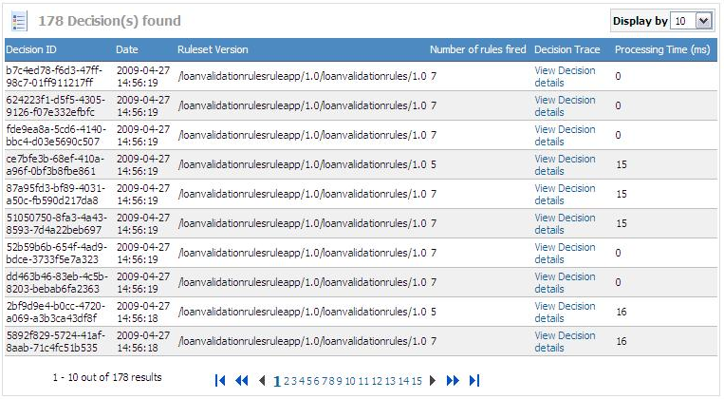
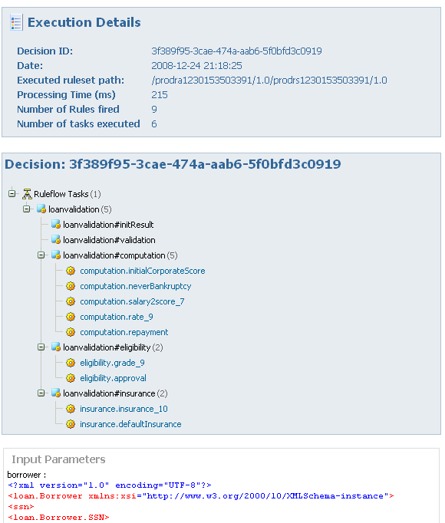
Decision Warehouse in RES

Slide 15
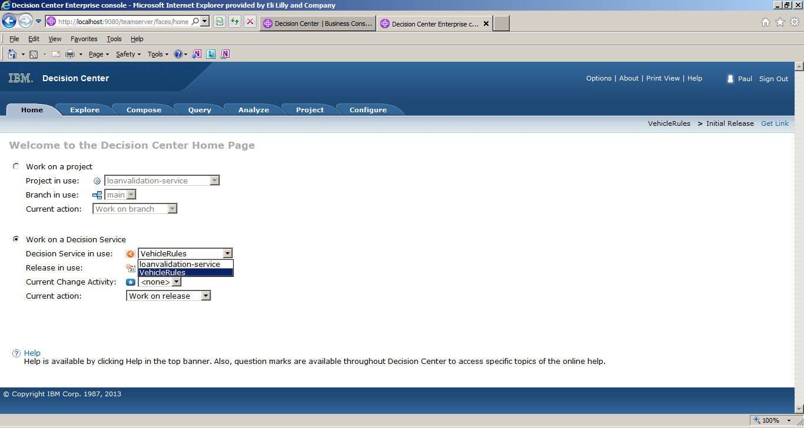
Rule Team Server
Web-based Console for Rule Maintenance
Access rule artifacts concurrently without conflict or delay
Represent complex policies using rule overrides and hierarchies
Take control of very large rulebases
with Smart Views, easy search
and reporting
Get automatic notification of potential
rule conflicts, redundancies
Versioning, Rule change notifications
See where rules are used across
projects using queries
Hot-deploy rule changes in minutes
Secure, integrated with enterprise security facility including single sign-on

Slide 16
RTS Capabilities
Testing / Simulating
  Decision Validation Services
Auditing
  Version Management
  Baseline
  Query-based reporting
Deploying
  Query base Extraction
  Rule service management
Administration and configuration
  Authorization policies
  Rule Service
  Display Options
Authoring
  Plain English, Decision Table, Decision Tree
  Quick edit mode using MS Office
  Templates
Managing
  Queries
  Smart Views
  Version Management
  Baseline
Validating
  Syntactic Check
  Semantic Check
  Semantic Queries

Slide 17
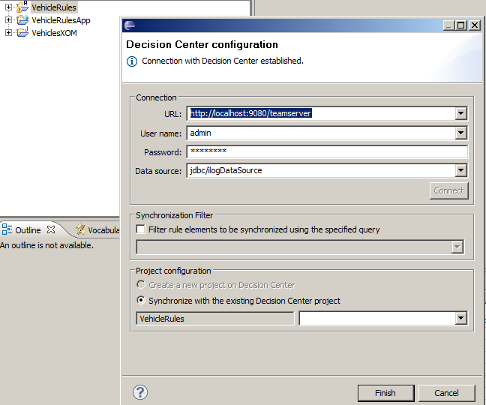
Rule Designer > Rule Team Server

Slide 18
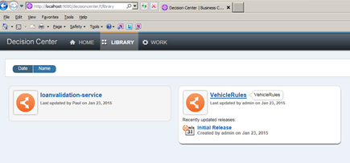
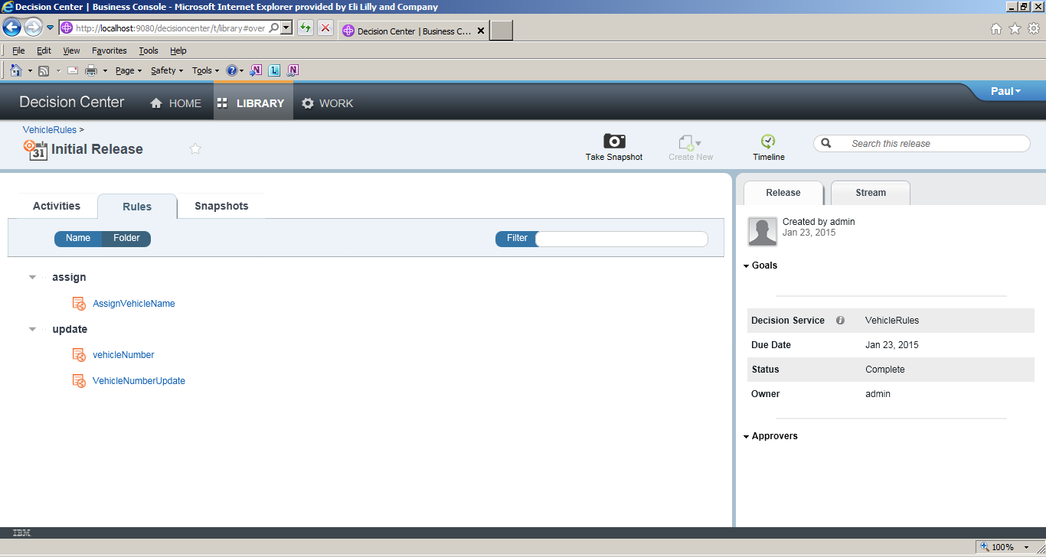
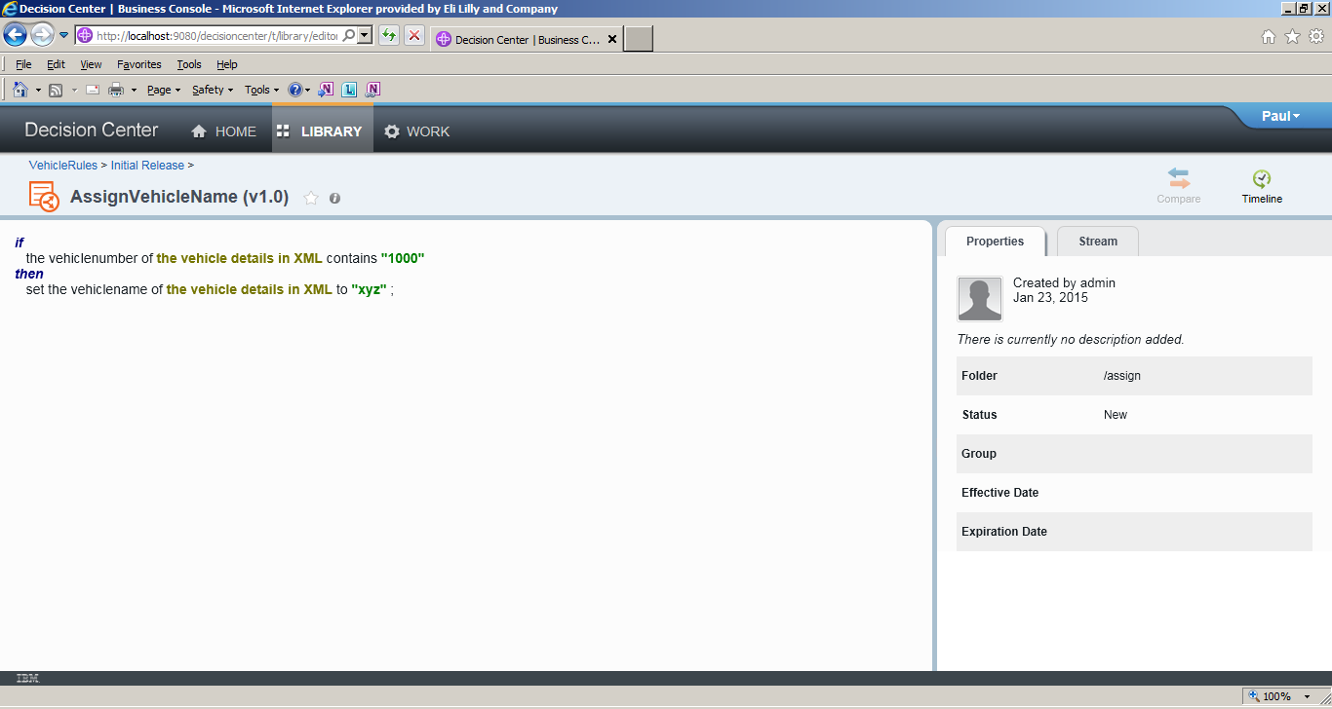
Business Console

Slide 19
Business Console
Rule Changes from Business User, most of the team server features
Rich GUI
Rule Governance which can enable Release Handling
Versioning helps in Tracking changes
Testing and Deployment capabilities

Slide 20
Rule Solution for Office
Business user rule authoring and maintenance using Microsoft Office Word and Excel
Decision table editing in MS Excel 2007
Automatic Spread sheet generation from RTS
Additional DT menus in MS Excel
Automatic Gap / Overlap detection in the spreadsheet
Action rules and RuleFlow editing in MS Word 2007
Automatic Document generation from RTS
Additional Rule menus in MS Word
Guided rule edition in Word
Vocabulary access

Slide 21
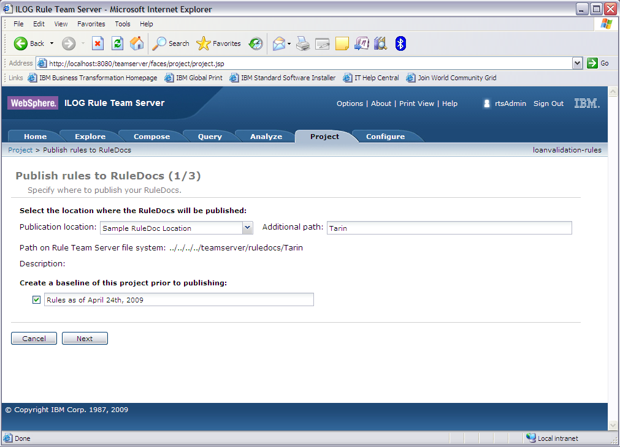
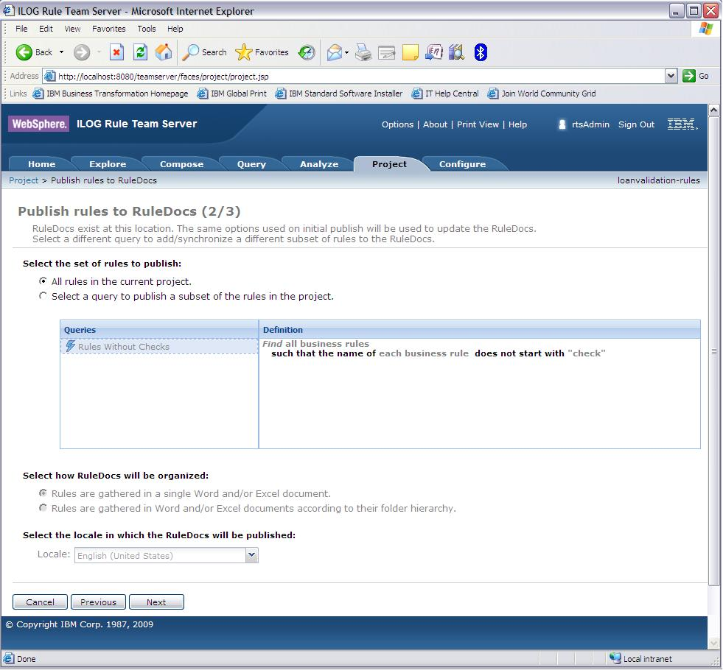
Rule Solution for Office
Publishing rule docs from RTS

Slide 22
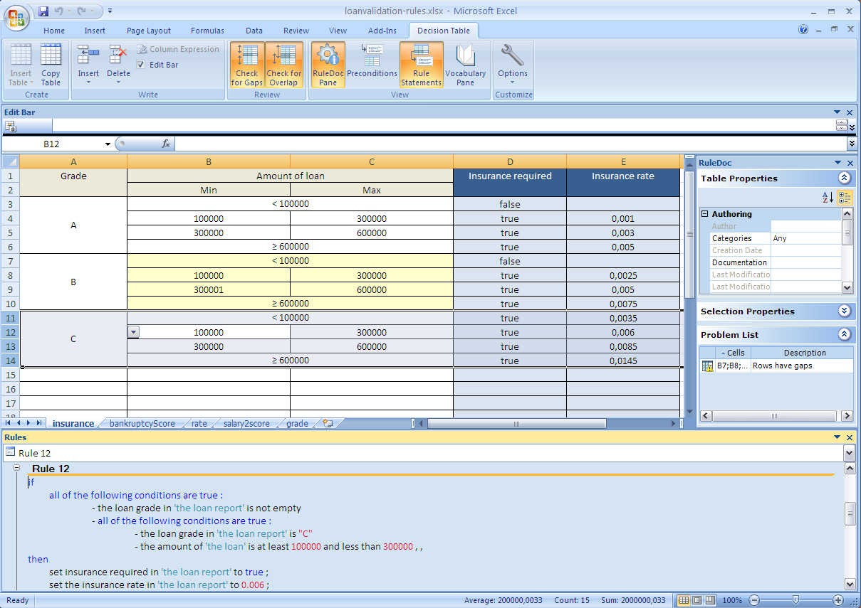
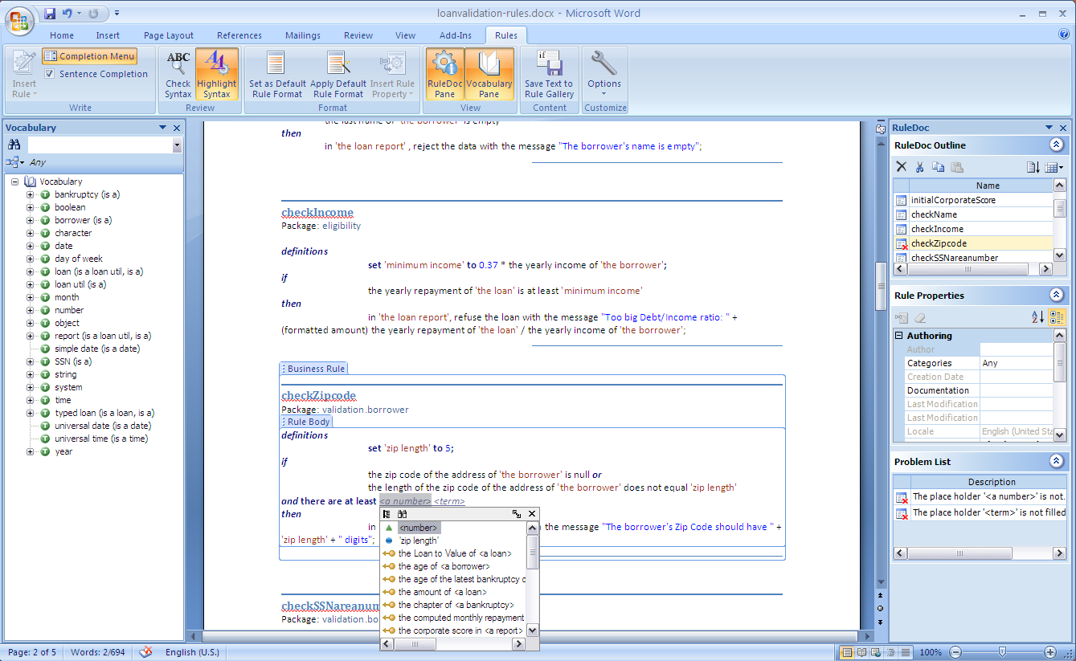
Rule Solution for Office Docs

Slide 23
Testing > Decision Validation Services
  Scenario Based Testing in Rule Studio, Team Server and Business Console
  Business impact simulation in Rule Team Server
  Scenario configuration and customization in Rule Studio
  Audit - Decision Warehouse in Rule Execution Server

Slide 24
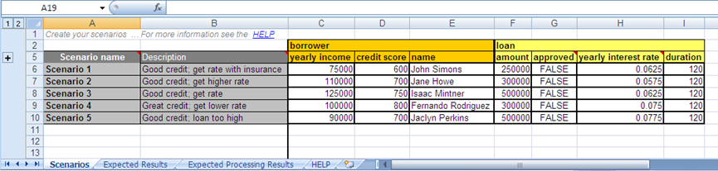
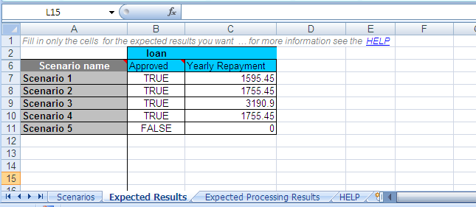
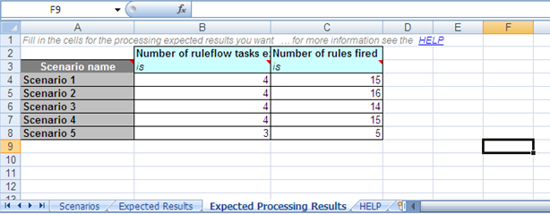
Decision Validation Services
Scenarios
Expected
Results

Slide 25
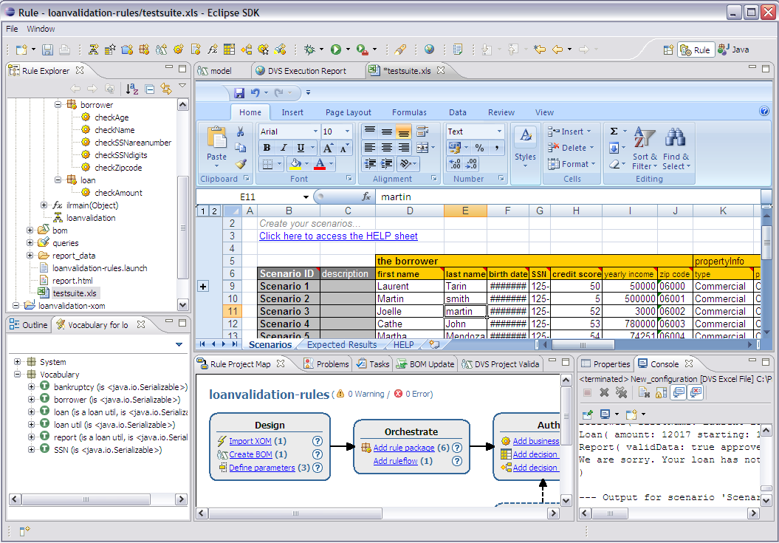
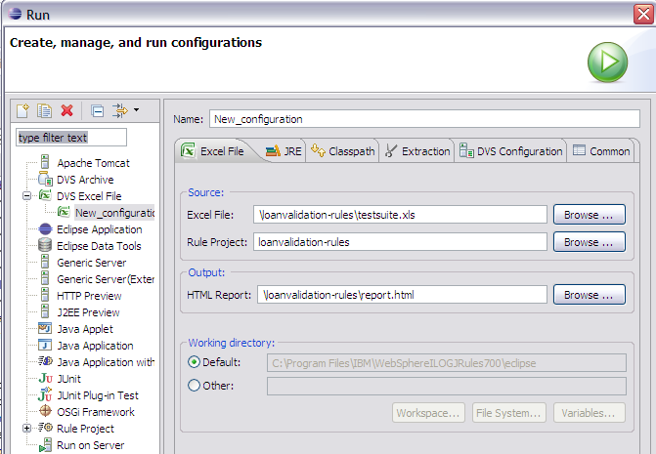
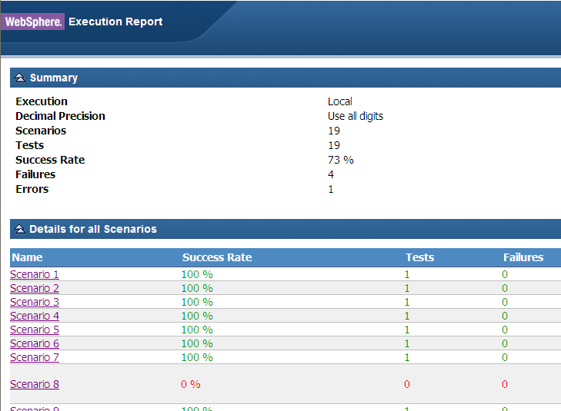
Rule Studio DVS Execution
Configuration
editing
Detailed Scenario
Reports

